Slide 1
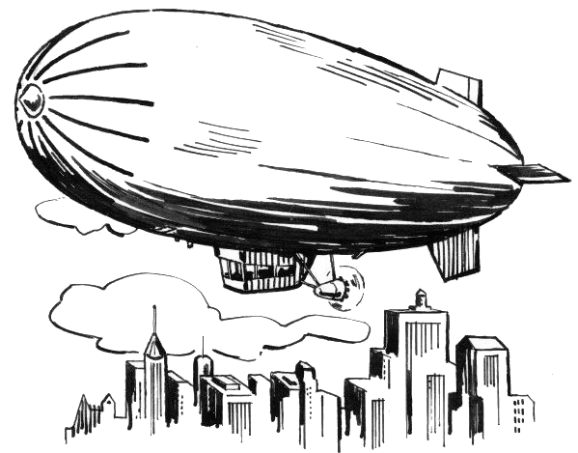
ENB354 ZEPHYR Project 2012
Group 4

Slide 2
The ZEPHYR Project
Design, build, test and demonstrate a dirigible search and rescue platform for ARCAA.
The UAV must be designed for use in indoor disaster zones such as earthquakes where personnel would be unable to enter safely.
The rescue UAV will be able to autonomously navigate its way throughout the disaster zone and search for survivors.
If any survivors are found the rescue platform will then deliver a small rescue package to the survivor.
Joshua Ham n8306214

Slide 3
Project High Level Objectives
High Level Objective 1:
The UAV must:
Circumnavigate the disaster zone without colliding with walls or the floor.
Remain within 1m of the walls.
High Level Objective 2:
The UAV must:
Autonomously search the disaster zone for distinctly coloured survivors.
Locate survivors position and notify the Ground control station.
High Level Objective 3:
The UAV must:
Deliver a rescue package to a designated survivor.
To ensure these objectives are fulfilled a suitable team of students has been chosen as group 4.
Joshua Ham n8306214

Slide 4
Group 4 – Team Members
Name: | Role within Group: | Year of Study: | Degree:
Joshua Ham | Project Manager | 2nd | Aerospace Avionics
Craig Maher | Ground Control Station | 3rd | Software Engineering
Raymundo Garcia | Airframe & Payload | 3rd | Aerospace Avionics
Scott Wong | Power & Propulsion | 3rd | Aerospace Avionics
Sophie Taylor | Guidance, Navigation & Control | 3rd | Aerospace Avionics
Fazl Alabodi | Proximity Control & Collision Avoidance | 3rd | Aerospace Avionics
Alexander Leong | Image Processing | 3rd | Software Engineering
Jonathan Wai | Communications Interface | 3rd | Software Engineering
Joshua Ham n8306214

Slide 5
System Requirements
To help ensure that the customers needs are met the project System Requirement have been developed.
Total of 50 system requirements
Types of Requirements:
Physical Requirements
Functional Requirements
User Requirements
Performance Requirements
Each requirement has been traced from the High Level Objectives
Each group member will tell you about requirements which directly or indirectly affects the subsystem they are in charge of.
Refer to the Handout “system Requirements”
Joshua Ham n8306214

Slide 6
Concept of Operations
Shows the different subsystems
Gives a simple illustration of the system
Refer to the A4 hand out “CONOP”
Joshua Ham n8306214

Slide 7
Work Breakdown Structure
Each task is a work packet that must be completed
Clear Work Packets are the tasks that have been completed
Half Coloured Work Packets are in the process of being completed
Fully Coloured Work Packers have not begun
Colour | Process
Yellow | Deliverable
Green | Design Phase
Gray | Construction and Testing Phase
Refer to A3 handout “Work Breakdown Structure”
Joshua Ham n8306214

Slide 8
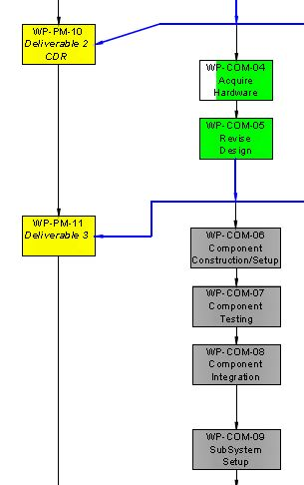
Work Breakdown Structure
Upcoming deliverables
Critical Design Review – W13 Semester 1
Full Designs – Wk6 Semester 2
Acceptance Testing – Wk 12 Semester 2
Full System Presentation – Wk 12 Semester 2
Upcoming Subsystem Work Packets
Revision of Designs – 20th July
Component Setup/Construction – 27th July
Component Testing – 1st August
Subsystem Setup/Construction – 10th August
Joshua Ham n8306214

Slide 9
System Architecture
Shows each of the Subsystems
Shows the relationships between each subsystem
All subsystem major components included
Useful during the Design Phase
Software and Hardware System Architecture
Each member has developed a subsystem architecture for the subsystem they are in charge of.
Refer to the A4 handout “system architecture”
Joshua Ham n8306214

Slide 10
Project Timeline
 |  |  | Project Phase
Design Phase
 |  |  | Construction and Testing Phase
 |  |  |  |  |  | Acceptance Tests
 |  |  | Upcoming Tasks
Acquire Hardware
 | Revise Design
 |  | Construction/Setup of Components
Full Timeline found on page 30 of the Project Management Plan
Joshua Ham n8306214

Slide 11
Project Timeline
Tasks taken from Work Breakdown Structure
Each Work Packet has been given a suitable amount of time to ensure they are completed on time.
A larger timeframe has been allocated for the “acquire hardware” work packet as parts may have long delivery times.
If a work Packet is finished earlier than expected this will enable later tasks to finish earlier.
Joshua Ham n8306214

Slide 12
Project Budget
4 Budgets: Financial Budget, Weight Budget, Power Budget and Data Budget
Amounts have been drawn from initial background research and trade studies
Total Available amount is $1600.
Financial Budget
Sub-System | Minimum Amount Required | Amount Allocated
 | Money | Percent | Money | Percent
Collision Avoidance and Proximity control | $102.70 | 13.35% | $150.00 | 11.11%
Communications and CCS | $27.00 | 3.51% | $50.00 | 3.70%
Airframe and Payload | $112.50 | 14.63% | $400.00 | 29.63%
Propulsion and Power | $100.00 | 10.40% | $200.00 | 14.81%
Imagery | $83.19 | 10.82% | $120.00 | 8.89%
Control and Navigation | $109.81 | 14.28% | $150.00 | 11.11%
Communication interface | $254.00 | 33.02% | $280.00 | 20.74%
Total | $789.20 | 100.00% | $1,350.00 | 100.00%
The Power, Weight and Data Budget can be found in the Project Management Plan, page 44.
Joshua Ham n8306214

Slide 13
Risk Management Plan
Many Different Risks
Technical
Schedule
Health and Safety
Each group member has been involved in the development of the Risk Management Plan so they know their roles when it comes to minimizing these risks.
Each team member will discuss the major risks that could affect their subsystem.
The Risk management plan can be found in Folder 1
Joshua Ham n8306214

Slide 14
Interface Control Document
22 Different Interfaces
Interface Types
Physical: - A plug or connector, bolts and screws
Electrical: - Power, Voltage
Signal: - Signal or communication standard, voltage signal
Information: - Data types or structures
Each member will discuss their subsystems main interfaces
Refer to the A4 handout “System Interfaces Diagram”
Joshua Ham n8306214

Slide 15
Airframe & Payload
Raymundo Garcia
Raymundo Garcia n62389848

Slide 16
High Level Objectives
What affects the airframe and payload subsystem?
1 & 2: The Airframe must be able to hold and carry all the onboard systems.
3: The UAV must be able to deliver a rescue package to a survivor.
List which HLO’s affect your subsystem and describe how
Raymundo Garcia n62389848

Slide 17
System Requirements
Req-1 – The Airframe Shall be a dirigible.
Rationale - This is a request of the client and can be traced from HLO 1, 2 & 3
Req-45 – The Package shall be delivered within 50cm of the survivor.
Rationale - This is the request of the client and can be traced from HLO 3.

Slide 18
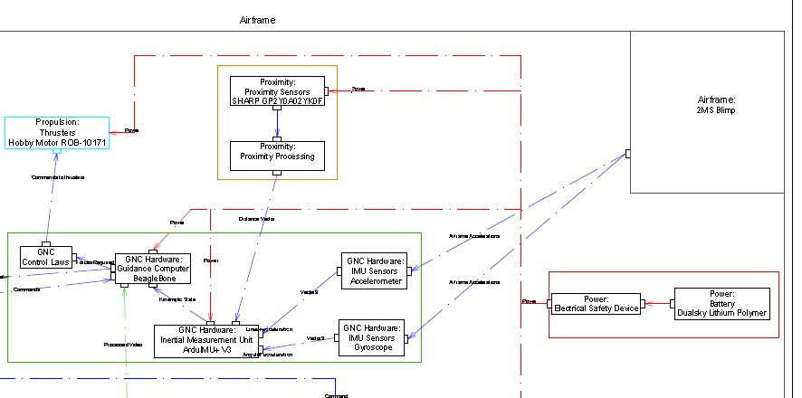
System Architecture - Airframe

Slide 19
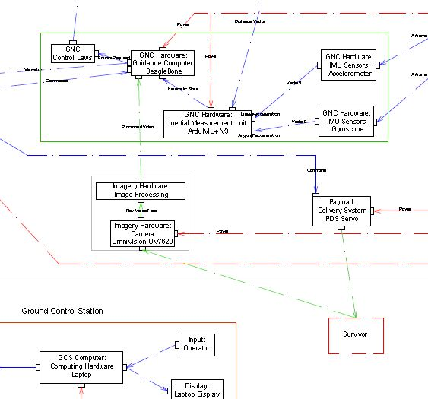
System Architecture - Airframe
This is the system architecture with your subsystem highlighted so that the panel can see where your subsystem fits in with the whole system
The panel will have a hard copy of the full system architecture so if the one on your slides is a little blury its ok.

Slide 20
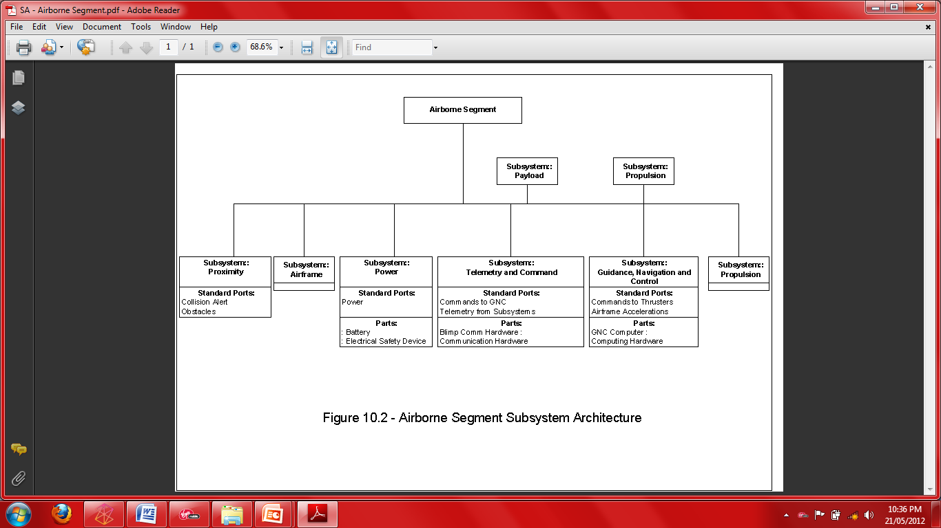
Subsystem Architecture - Airframe
This is were you talk about your subsystem – describing what it does and some of the components you will need – Put the system architecture that you used in your preliminary designs
All subsystems excluding the Ground Control Station will be position onboard the airframe.
Raymundo Garcia n62389848

Slide 21
Subsystem Architecture - Airframe
This is were you talk about your subsystem – describing what it does and some of the components you will need – Put the system architecture that you used in your preliminary designs

Slide 22
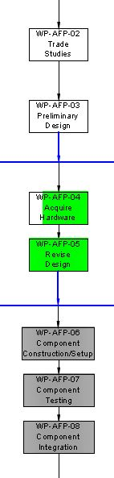
Work Packages
Completed Work Packets
WP-AFP-02 Trade Studies
- Collect and review information on the Airframe and Payload subsystem.
Investigate which products are best.
Completed on 10th May
Upcoming Work Packets
WP-AFP-04 Acquire Hardware: Purchase and Acquire necessary hardware
To be completed before 16 July.
WP-AFP-07 Component Testing: Test each component
To be Completed before 1st august
Raymundo Garcia n62389848

Slide 23
Weight Budget
Overall Lifting Capacity 500grams. But a 24% margin of error was added. This brought the lifting capacity to 380grams.
Ray – Say something like “We developed a Weight budget to help manage the overall weight of the system”. Say that these weight estimates came about because of initial research and the trade studies.
I will be discussing the financial budget,
Ray – Will discuss the weight budget
Scott – The power budget
Craig – The Data budget
So if you don’t need to discuss a budget to worry.
Sub-System | Required Amount | Actual Amount (380g)
 | Weight (grams) | Percent | Weight (grams) | Percent
Collision Avoidance and Proximity control | 19.2 | 5.5% | 20.9 | 5.5%
Communications and CCS | 7.3 | 2.2% | 8.36 | 2.2%
Airframe and Payload | 15 | 4.4% | 16.72 | 4.4%
Propulsion and Power | 223 | 64.5% | 245.1 | 64.5%
Imagery | 20.4 | 5.9% | 22.42 | 5.9%
Control and Navigation | 55 | 15.9% | 60.42 | 15.9%
Communication interface | 5.5 | 1.6% | 6.08 | 1.6%
Total | 345.4 | 100% | 380 | 100%

Slide 24
Risk Management
Here List some of the risks that may affect your subsystem. Not health and safety risks but schedule or techinical risks. Such as if a part doesn’t arrive on time.
This is not that important and you can remove if you want. But u can put it in there if you want

Slide 25
Trade studies
List here the outcomes of your trade study
What products you needed and which were chosen
List the criteria
Say something like “ I did a trade study comparing different types of ______. By comparing each product according to the criteria the product that fitted the ____ subsystem the most was the ____.
Maybe add a picture of it or something like that.

Slide 26
Interfaces
Here, Include some of your major interfaces; Diagrams or brief descriptions.
List which interface number it is and what it does.
Raymundo Garcia n62389848

Slide 27
Airframe Preliminary Designs
Try to save as much time for this section.
Include your designs here. Try to limit your designs for each of your subsystems.
Explain each of your designs simply but enough to tell the listener what is going on in the designs. Don’t go too detailed. If your doing software designs, include a flowchart and describe the steps.
Raymundo Garcia n62389848

Slide 28
Payload Preliminary designs
Include your designs here. Try to limit your designs for each of your subsystems.
Explain each of your designs simply but enough to tell the listener what is going on in the designs. Don’t go too detailed. If your doing software designs, include a flowchart and describe the steps.
Raymundo Garcia n62389848

Slide 29
Maybe give a brief summary of your previous slides:
Then introduce the next speaker

Slide 30
Power & Propulsion
Scott Wong
Scott Wong n6406468

Slide 31
High Level Objectives
What affects the Power and Propulsion subsystem?
HLO 1 & 2:
Provide power and propulsion to enable the UAV to navigate throughout the room
HLO 3:
Provide power and propulsion to the systems to enable the UAV to deliver the payload in the position specified by the navigation system.
Scott Wong n6406468

Slide 32
System Requirements
Req-17 :
The Guidance, Navigation and Control subsystem shall provide control commands to the propulsion subsystem in order to move the airborne segment to a specified position.
Req-19:
The propulsion system shall be capable of changing the altitude of the airborne segment to a commanded altitude above the floor of the room.
Req – 20:
The propulsion system shall be able to change the speed of the airborne segment to a commanded speed.
Req – 22:
The airborne segment shall avoid detected obstacles.
Req – 46:
The airborne segment shall be capable of completing the procedure of test case 1 within 10 minutes.
Req – 47:
The airborne segment shall be capable of completing the procedure of test case 2 within 20 minutes.

Slide 33
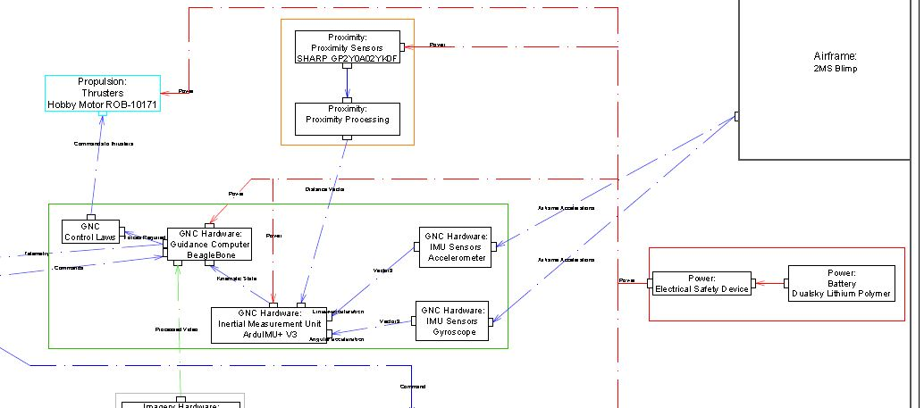
System Architecture

Slide 34
Subsystem Architecture
Explain Subsystem Use the diagram from preliminary designs
This is were you talk about your subsystem – describing what it does and some of the components you will need – Put the system architecture that you used in your preliminary designs
Scott Wong n6406468

Slide 35
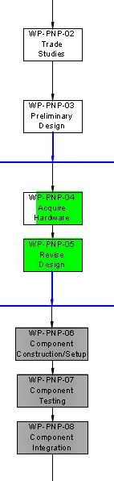
Work Packages
Choose 2 to talk about
WP – (subsystem) – 01 Background Research - Due 23rd of April
WP – (subsystem)- 02 Trade Study - Due 9th May
WP- (subsystem) – 03 Preliminary Design - Due 24th
WP – (subsystem) -04 Acquire hardware - Due 16th July
WP-(subsystem) – 05 Revise Design - Due 20th July
WP-(subsystem)-06 Component Construction/Setup - Due 27th July
WP-Subsystem-07 Component Testing - Due 1st august
WP-Subsystem-08 Component Integration - Due 7th august
WP-subsystem-09 Subsystem setup - Due 18th august
WP-subsystem-10 subsystem testing - Due 25th august
WP-subsystem-11 primary integration - 5th of September
Scott Wong n6406468

Slide 36
Power Budget
Overall Lifting Capacity Overall voltage = 11.2v
Scott – Say something like “We developed a power budget to help manage the overall power of the system”. Say that these power estimates came about because of initial research and the trade studies.
Subsystem | Required Amount
 | Voltage (V)
Collision Avoidance and Proximity control | 5
Communications | 4.5
Airframe and Payload | 3
Propulsion and Power | 3
Imagery | 5
Control and Navigation | 4.2
Communication interface | 5

Slide 37
Risk Management
Here List some of the risks that may affect your subsystem. Not health and safety risks but schedule or techinical risks. Such as if a part doesn’t arrive on time.
This is not that important and you can remove if you want. But u can put it in there if you want

Slide 38
Trade studies
List here the outcomes of your trade study
What products you needed and which were chosen
List the criteria
Say something like “ I did a trade study comparing different types of ______. By comparing each product according to the criteria the product that fitted the ____ subsystem the most was the ____.
Maybe add a picture of it or something like that.

Slide 39
Interfaces
Here, Include some of your major interfaces; Diagrams or brief descriptions.
List which interface number it is and what it does.
Raymundo Garcia n62389848

Slide 40
Power Preliminary Designs
Try to save as much time for this section.
Include your designs here. Try to limit your designs for each of your subsystems.
Explain each of your designs simply but enough to tell the listener what is going on in the designs. Don’t go too detailed. If your doing software designs, include a flowchart and describe the steps.
Raymundo Garcia n62389848

Slide 41
Propulsion Preliminary Designs
Try to save as much time for this section.
Include your designs here. Try to limit your designs for each of your subsystems.
Explain each of your designs simply but enough to tell the listener what is going on in the designs. Don’t go too detailed. If your doing software designs, include a flowchart and describe the steps.
Raymundo Garcia n62389848

Slide 42
Guidance, Navigation & Control
Sophie Taylor
Sophie Taylor n6362575

Slide 43
High Level Objectives
What affects the GNC subsystem?
Everything.
HLO 1 :
Ensures the UAV navigates its way around the room
Control the propulsion system and the give current position of UAV
HLO 2:
Control the propulsion system
Give position of UAV and survivors
Control the path of the UAV
HLO 3:
Control the propulsion system
Give the Payload system the order to release the payload
Sophie Taylor n6362575

Slide 44
System Requirements
Req 16 - Airframe propulsion control commands shall be generated by the Guidance, Navigation and Control subsystem.
Req 17 - The Guidance, Navigation and Control subsystem shall provide control commands to the propulsion subsystem in order to move the airborne segment to a specified position.
Req 18 - The Guidance, Navigation and Control subsystem shall prevent the airborne segment from leaving the disaster zone.
Req 49 - The Guidance, Navigation and Control subsystem shall determine the position of the airborne segment to within 25cm.

Slide 45
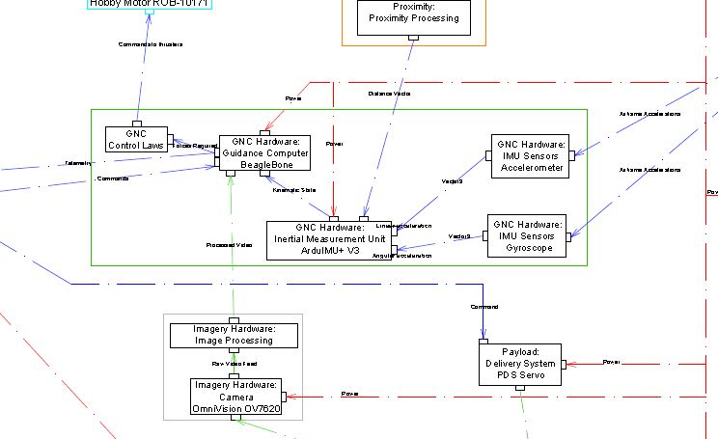
Subsystem Architecture
Sophie Taylor n6362575

Slide 46
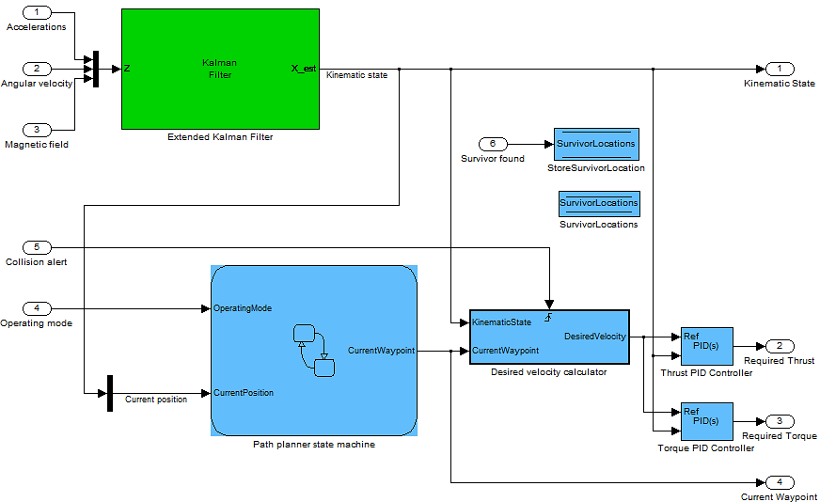
Subsystem Architecture
Sophie Taylor n6362575
Notes:
This is were you talk about your subsystem – describing what it does and some of the componens you will need – Put the system architecture that you used in your preliminary designs
<number>

Slide 47
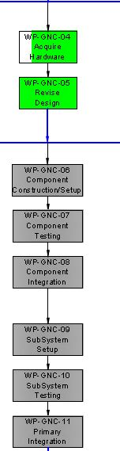
Work Packages
WP-GNC-06 Revise Design - Due 20th July
Incorporate power, physical harnesses, d-bus lower level design
Detail state machine transitions
WP-GNC-06 Component Construction/Setup - Due 27th July
Design of controllers, filters, etc
Generate code from Matlab/Simulink
Sophie Taylor n6362575

Slide 48
Risk Management REMOV PLS

Slide 49
Trade studies
Guidance computer
Wanted full Linux computer for ease of development; primary criteria were weight, power, processor capability
Selected BeagleBone
IMU
Criteria: degrees of freedom, onboard MCU
Selected ArduIMU+ V3

Slide 50
Interfaces
Power – 5v, several Watts
Proximity avoidance – Software interrupt
Other software subsystems – D-Bus
Airframe
IMU strapped to airframe with foam padding to dampen vibrations
GC in gondola
Sophie Taylor
n6362575

Slide 51
GNC Preliminary Designs
Sophie Taylor
n6362575

Slide 52
Proximity Control and Collision Avoidance Fazl Alabodi
Fazl Alabodi n07239734S

Slide 53
High Level Objectives
What affects the airframe and payload subsystem?
HLO 1:
The UAV must not collide with walls, floor or ceiling
UAV must stay within 1m of the walls
HLO 2:
- The UAV must not collide with walls, floor or ceiling
Fazl Alabodi n07239734

Slide 54
System Requirements
Req 21 – The airborne segment shall detect obstacles in its path before the airborne segment collides with the obstacles
Req 22 – The airborne segment shall avoid detected obstacles.
Req 44 – When operating in the circumnavigation task the minimum distance between the airborne segment and the closest wall shall be no greater than 1 metre.
Req 45 – The package shall be delivered within 50cm of the designated survivor.
Req 46 – The airborne segment shall be capable of completing the procedure of test case 1 within 10 minutes.
Req 47 – The airborne segment shall be capable of completing the procedure of test case 2 within 20 minutes.
You not necessarily have to do all. List the main ones and summarise the rest

Slide 55
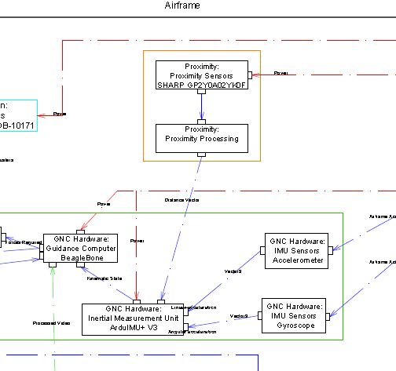
System Architecture
This is the system architecture with your subsystem highlighted so that the panel can see where your subsystem fits in with the whole system
The panel will have a hard copy of the full system architecture so if the one on your slides is a little blury its ok.
Fazl Alabodi n07239734

Slide 56
Subsystem Architecture
Explain Subsystem
This is were you talk about your subsystem – describing what it does and some of the components you will need – Put the system architecture that you used in your preliminary designs
Fazl Alabodi n07239734

Slide 57
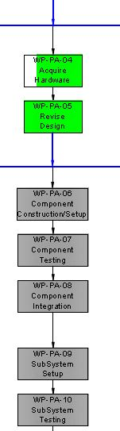
Work Packages
Choose 2 to talk about
WP – (subsystem) – 01 Background Research - Due 23rd of April
WP – (subsystem)- 02 Trade Study - Due 9th May
WP- (subsystem) – 03 Preliminary Design - Due 24th
WP – (subsystem) -04 Acquire hardware - Due 16th July
WP-(subsystem) – 05 Revise Design - Due 20th July
WP-(subsystem)-06 Component Construction/Setup - Due 27th July
WP-Subsystem-07 Component Testing - Due 1st august
WP-Subsystem-08 Component Integration - Due 7th august
WP-subsystem-09 Subsystem setup - Due 18th august
WP-subsystem-10 subsystem testing - Due 25th august
WP-subsystem-11 primary integration - 5th of September
Fazl Alabodi n07239734

Slide 58
Risk Management
Here List some of the risks that may affect your subsystem. Not health and safety risks but schedule or techinical risks. Such as if a part doesn’t arrive on time.
This is not that important and you can remove if you want. But u can put it in there if you want

Slide 59
Trade studies
List here the outcomes of your trade study
What products you needed and which were chosen
List the criteria
Say something like “ I did a trade study comparing different types of ______. By comparing each product according to the criteria the product that fitted the ____ subsystem the most was the ____.
Maybe add a picture of it or something like that.

Slide 60
Interfaces
Here, Include some of your major interfaces; Diagrams or brief descriptions.
List which interface number it is and what it does.
Raymundo Garcia n62389848

Slide 61
Proximity Control Preliminary Designs
Try to save as much time for this section.
Include your designs here. Try to limit your designs for each of your subsystems.
Explain each of your designs simply but enough to tell the listener what is going on in the designs. Don’t go too detailed. If your doing software designs, include a flowchart and describe the steps.
Raymundo Garcia n62389848

Slide 62
Image Processing Alexander Leong
Alec Leong n7492553

Slide 63
High Level Objectives
What affects the airframe and payload subsystem?
HLO 2:
- The UAV must be able to search and identify a survivor wearing distinctly coloured clothing
Alec Leong n7492553

Slide 64
You not necessarily have to do all. List the main ones and summarise the rest
Requirements
Req 6 – The search and rescue blimp shall communicate to the Ground Control Station the imagery.
Req 10 – The system shall communicate to external Ground Control Stations the imagery.
Req 15 – The image processing system shall be able to detect all three distinctly coloured survivors (green, pink and yellow).
Req 26 – The Ground Control Station shall display imagery from the search and rescue blimp
Req 37 – The Ground Control Station shall alert the operator vocally by stating the clothes colour of the detected survivor through a speaker upon detecting a coloured survivor
Req 46 –The airborne segment shall be capable of completing the procedure of test case 1 within 10 minutes.
Req 47 – The airborne segment shall be capable of completing the procedure of test case 2 within 20 minutes.
Req 48 – The image processing system shall be able to determine the position of all three coloured survivors to an accuracy of 40cm.
Req 49 - The Guidance, Navigation and Control subsystem shall determine the position of the airborne segment to within 25cm.

Slide 65
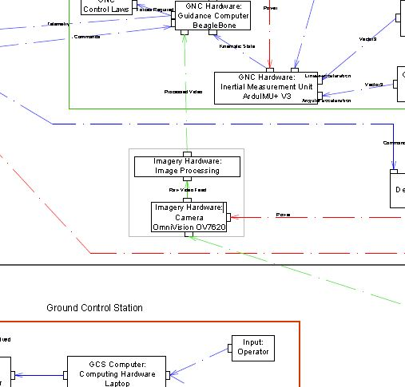
System Architecture
This is the system architecture with your subsystem highlighted so that the panel can see where your subsystem fits in with the whole system
The panel will have a hard copy of the full system architecture so if the one on your slides is a little blury its ok.
Fazl Alabodi n07239734

Slide 66
Subsystem Architecture
Explain Subsystem
This is were you talk about your subsystem – describing what it does and some of the components you will need – Put the system architecture that you used in your preliminary designs
Alec Leong n7492553

Slide 67
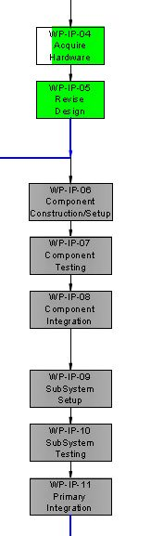
Work Packages
Choose 2 to talk about
WP – (subsystem) – 01 Background Research - Due 23rd of April
WP – (subsystem)- 02 Trade Study - Due 9th May
WP- (subsystem) – 03 Preliminary Design - Due 24th
WP – (subsystem) -04 Acquire hardware - Due 16th July
WP-(subsystem) – 05 Revise Design - Due 20th July
WP-(subsystem)-06 Component Construction/Setup - Due 27th July
WP-Subsystem-07 Component Testing - Due 1st august
WP-Subsystem-08 Component Integration - Due 7th august
WP-subsystem-09 Subsystem setup - Due 18th august
WP-subsystem-10 subsystem testing - Due 25th august
WP-subsystem-11 primary integration - 5th of September
Alec Leong n7492553

Slide 68
Risk Management
Here List some of the risks that may affect your subsystem. Not health and safety risks but schedule or techinical risks. Such as if a part doesn’t arrive on time.
This is not that important and you can remove if you want. But u can put it in there if you want

Slide 69
Trade studies
List here the outcomes of your trade study
What products you needed and which were chosen
List the criteria
Say something like “ I did a trade study comparing different types of ______. By comparing each product according to the criteria the product that fitted the ____ subsystem the most was the ____.
Maybe add a picture of it or something like that.

Slide 70
Interfaces
Here, Include some of your major interfaces; Diagrams or brief descriptions.
List which interface number it is and what it does.
Raymundo Garcia n62389848

Slide 71
Proximity Control Preliminary Designs
Try to save as much time for this section.
Include your designs here. Try to limit your designs for each of your subsystems.
Explain each of your designs simply but enough to tell the listener what is going on in the designs. Don’t go too detailed. If your doing software designs, include a flowchart and describe the steps.
Raymundo Garcia n62389848

Slide 72
Communications Interface Jonathan Wai
Jonathan Wai

Slide 73
High Level Objectives
What affects the airframe and payload subsystem?
HLO 1:
- Send telemetry to and from the GCS about the UAV’s current position and where it needs to go
HLO 2:
- Send telemetry to and from the GCS about the UAV’s current position and where it needs to go
HLO 3:
- Send telemetry to and from the GCS about the UAV’s current position and where it needs to go
Jonathan Wai

Slide 74
System Requirements
Req 2- The Ground Control Station shall communicate to the search and rescue blimp the commands.
Req 3 –The search and rescue blimp shall communicate to the Ground Control Station the onboard sensor readings.
Req 4-The search and rescue blimp shall communicate to the Ground Control Station command acknowledgments
Req 5 –The search and rescue blimp shall communicate to the Ground Control Station the system mode.
Req 6 –The search and rescue blimp shall communicate to the Ground Control Station the imagery.
Req 17 –The Guidance, Navigation and Control subsystem shall provide control commands to the propulsion subsystem in order to move the airborne segment to a specified position.
Req 19 –The propulsion system shall be capable of changing the altitude of the airborne segment to a commanded altitude above the floor of the room.
Req 20 –The propulsion system shall be able to change the speed of the airborne segment to a commanded speed.
Req 22 – The airborne segment shall avoid detected obstacles.
Req 27 –The Ground Control Station shall display command acknowledgments from the search and rescue blimp
Req 37 –The Ground Control Station shall alert the operator vocally by stating the clothes colour of the detected survivor through a speaker upon detecting a coloured survivor
Req 44 – When operating in the circumnavigation task the minimum distance between the airborne segment and the closest wall shall be no greater than 1 metre.
Req 46 – The airborne segment shall be capable of completing the procedure of test case 1 within 10 minutes.
Req 47 – The airborne segment shall be capable of completing the procedure of test case 2 within 20 minutes.
Req 49 – The Guidance, Navigation and Control subsystem shall determine the position of the airborne segment to within 25cm.
Req 50 -The airborne segment shall be able to maintain a communications link with the ground control station at a minimum distance of 20 metres.

Slide 75
Subsystem Architecture
Explain Subsystem
This is were you talk about your subsystem – describing what it does and some of the components you will need – Put the system architecture that you used in your preliminary designs
Jonathan Wai

Slide 76
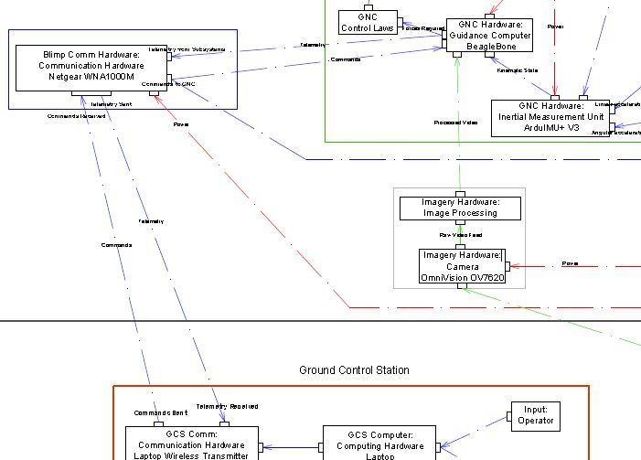
System Architecture
This is the system architecture with your subsystem highlighted so that the panel can see where your subsystem fits in with the whole system
The panel will have a hard copy of the full system architecture so if the one on your slides is a little blury its ok.
Fazl Alabodi n07239734

Slide 77
Subsystem Architecture
Explain Subsystem
This is were you talk about your subsystem – describing what it does and some of the components you will need – Put the system architecture that you used in your preliminary designs
Alec Leong n7492553

Slide 78
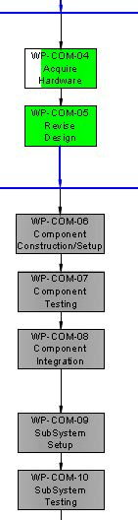
Work Packages
Choose 2 to talk about
WP – (subsystem) – 01 Background Research - Due 23rd of April
WP – (subsystem)- 02 Trade Study - Due 9th May
WP- (subsystem) – 03 Preliminary Design - Due 24th
WP – (subsystem) -04 Acquire hardware - Due 16th July
WP-(subsystem) – 05 Revise Design - Due 20th July
WP-(subsystem)-06 Component Construction/Setup - Due 27th July
WP-Subsystem-07 Component Testing - Due 1st august
WP-Subsystem-08 Component Integration - Due 7th august
WP-subsystem-09 Subsystem setup - Due 18th august
WP-subsystem-10 subsystem testing - Due 25th august
WP-subsystem-11 primary integration - 5th of September
Alec Leong n7492553

Slide 79
Risk Management
Here List some of the risks that may affect your subsystem. Not health and safety risks but schedule or techinical risks. Such as if a part doesn’t arrive on time.
This is not that important and you can remove if you want. But u can put it in there if you want

Slide 80
Trade studies
List here the outcomes of your trade study
What products you needed and which were chosen
List the criteria
Say something like “ I did a trade study comparing different types of ______. By comparing each product according to the criteria the product that fitted the ____ subsystem the most was the ____.
Maybe add a picture of it or something like that.

Slide 81
Interfaces
Here, Include some of your major interfaces; Diagrams or brief descriptions.
List which interface number it is and what it does.
Raymundo Garcia n62389848

Slide 82
Communications Preliminary Designs
Try to save as much time for this section.
Include your designs here. Try to limit your designs for each of your subsystems.
Explain each of your designs simply but enough to tell the listener what is going on in the designs. Don’t go too detailed. If your doing software designs, include a flowchart and describe the steps.
Raymundo Garcia n62389848

Slide 83
Ground Control Station
Craig Maher
Craig Maher – N7510683

Slide 84
High Level Objectives
What affects the airframe and payload subsystem?
.
System Requirements
Req-1 –
Craig Maher – N7510683

Slide 85
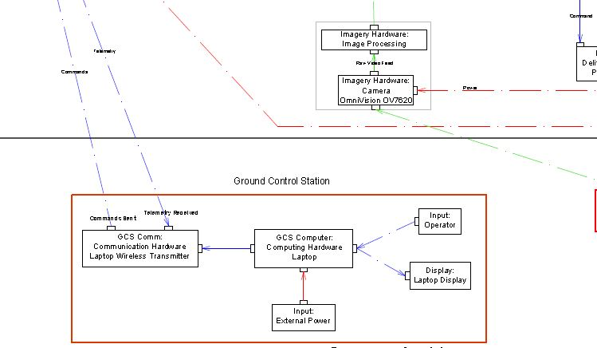
System Architecture
This is the system architecture with your subsystem highlighted so that the panel can see where your subsystem fits in with the whole system
The panel will have a hard copy of the full system architecture so if the one on your slides is a little blury its ok.
Fazl Alabodi n07239734

Slide 86
Subsystem Architecture
Explain Subsystem
This is were you talk about your subsystem – describing what it does and some of the components you will need – Put the system architecture that you used in your preliminary designs
Craig Maher – N7510683

Slide 87
Work Packages
Choose 2 to talk about
WP – (subsystem) – 01 Background Research - Due 23rd of April
WP – (subsystem)- 02 Trade Study - Due 9th May
WP- (subsystem) – 03 Preliminary Design - Due 24th
WP – (subsystem) -04 Acquire hardware - Due 16th July
WP-(subsystem) – 05 Revise Design - Due 20th July
WP-(subsystem)-06 Component Construction/Setup - Due 27th July
WP-Subsystem-07 Component Testing - Due 1st august
WP-Subsystem-08 Component Integration - Due 7th august
WP-subsystem-09 Subsystem setup - Due 18th august
WP-subsystem-10 subsystem testing - Due 25th august
WP-subsystem-11 primary integration - 5th of September
Alec Leong n7492553

Slide 88
Risk Management
Here List some of the risks that may affect your subsystem. Not health and safety risks but schedule or techinical risks. Such as if a part doesn’t arrive on time.
This is not that important and you can remove if you want. But u can put it in there if you want

Slide 89
Data budget

Slide 90
Trade studies
List here the outcomes of your trade study
What products you needed and which were chosen
List the criteria
Say something like “ I did a trade study comparing different types of ______. By comparing each product according to the criteria the product that fitted the ____ subsystem the most was the ____.
Maybe add a picture of it or something like that.

Slide 91
Interfaces
Here, Include some of your major interfaces; Diagrams or brief descriptions.
List which interface number it is and what it does.
Raymundo Garcia n62389848

Slide 92
GCS Preliminary Designs
Try to save as much time for this section.
Include your designs here. Try to limit your designs for each of your subsystems.
Explain each of your designs simply but enough to tell the listener what is going on in the designs. Don’t go too detailed. If your doing software designs, include a flowchart and describe the steps.
Raymundo Garcia n62389848

Slide 93
Conclusion
Project Phase
Design Phase moving into Construction and Testing Phase
Next Work Packets
Acquire Hardware
Next Deliverable Detailed Designs Week 6 Semester 2

Slide 94
Questions?

